Slide 1
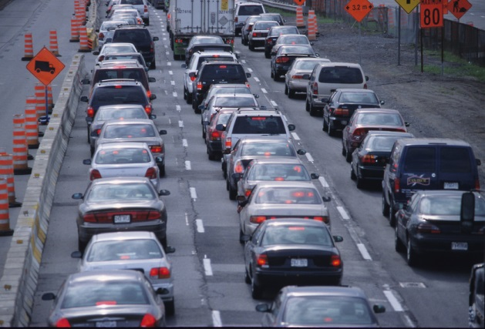
Updating a Fuel-based Inventory of Vehicle Emissions
for Chemical Transport Modeling during LISTOS
Brian C. McDonald, Ph.D.
Acknowledgments: Meng Li (CIRES/NOAA), Stuart McKeen (CIRES/NOAA), Luke Valin (EPA)
TEMPO Science Team Meeting (June 6, 2019)

Slide 2
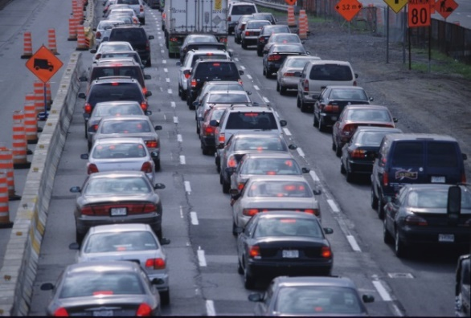
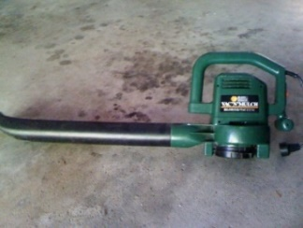
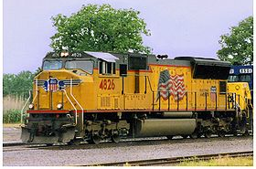
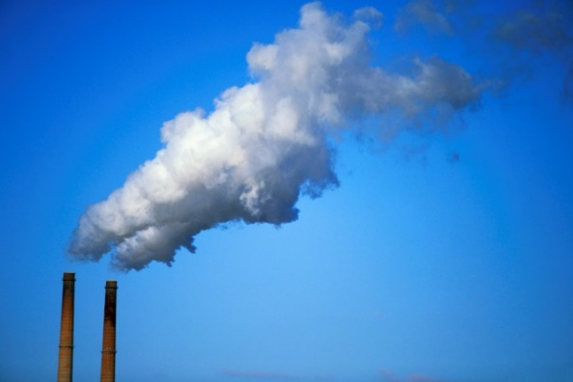
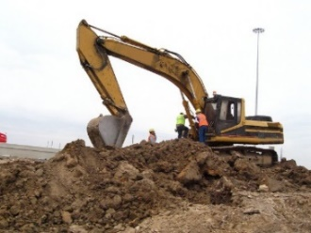
Current US Budget of Nitrogen Oxides Emissions (2018)
Highway Vehicles
Off-Highway
Vehicles
Power
Plants
Industrial Facilities
~230 million cars +
~3 million freight trucks
~600 coal-fired power plants
~1700 natural-gas plants
~33%
~25%
~10%
~30%
Mobile Sources
Stationary Sources
Source: EPA Emissions Trend Report

Slide 3
Summer Field Studies Suggest Mobile Source NO_{x} Overestimated in NEI
Year | Region | Measurement | Findings
2011 | Baltimore/DC | Aircraft (DISCOVER-AQ) | Mobile sources overestimated by 50-70% [Anderson et al., Atmos. Environ. 2014]
2013 | Southeast | Aircraft (SEAC⁴RS) | Reduce mobile and industrial sources by 30-60% [Travis et al., Atmos. Chem. Phys. 2016]
2013 | Urban Texas | Satellite Inversion (DISCOVER-AQ) | Reduce mobile, area, point sources by 30-60% [Souri et al., Atmos. Env. 2016]
2013 | Southeast | Aircraft (SENEX) | Mobile sources overestimated by ~30% [McDonald et al., Environ. Sci. Technol. 2018]

Slide 4
Research Objectives
Update mobile source NO_{x} emissions using a fuel-based approach for recent field campaigns (e.g., LISTOS)
Utilize regional chemical transport model and evaluate with TROPOMI and Pandora NO₂ column data
What can TEMPO data provide that helps improve bottom-up emission inventories?

Slide 5
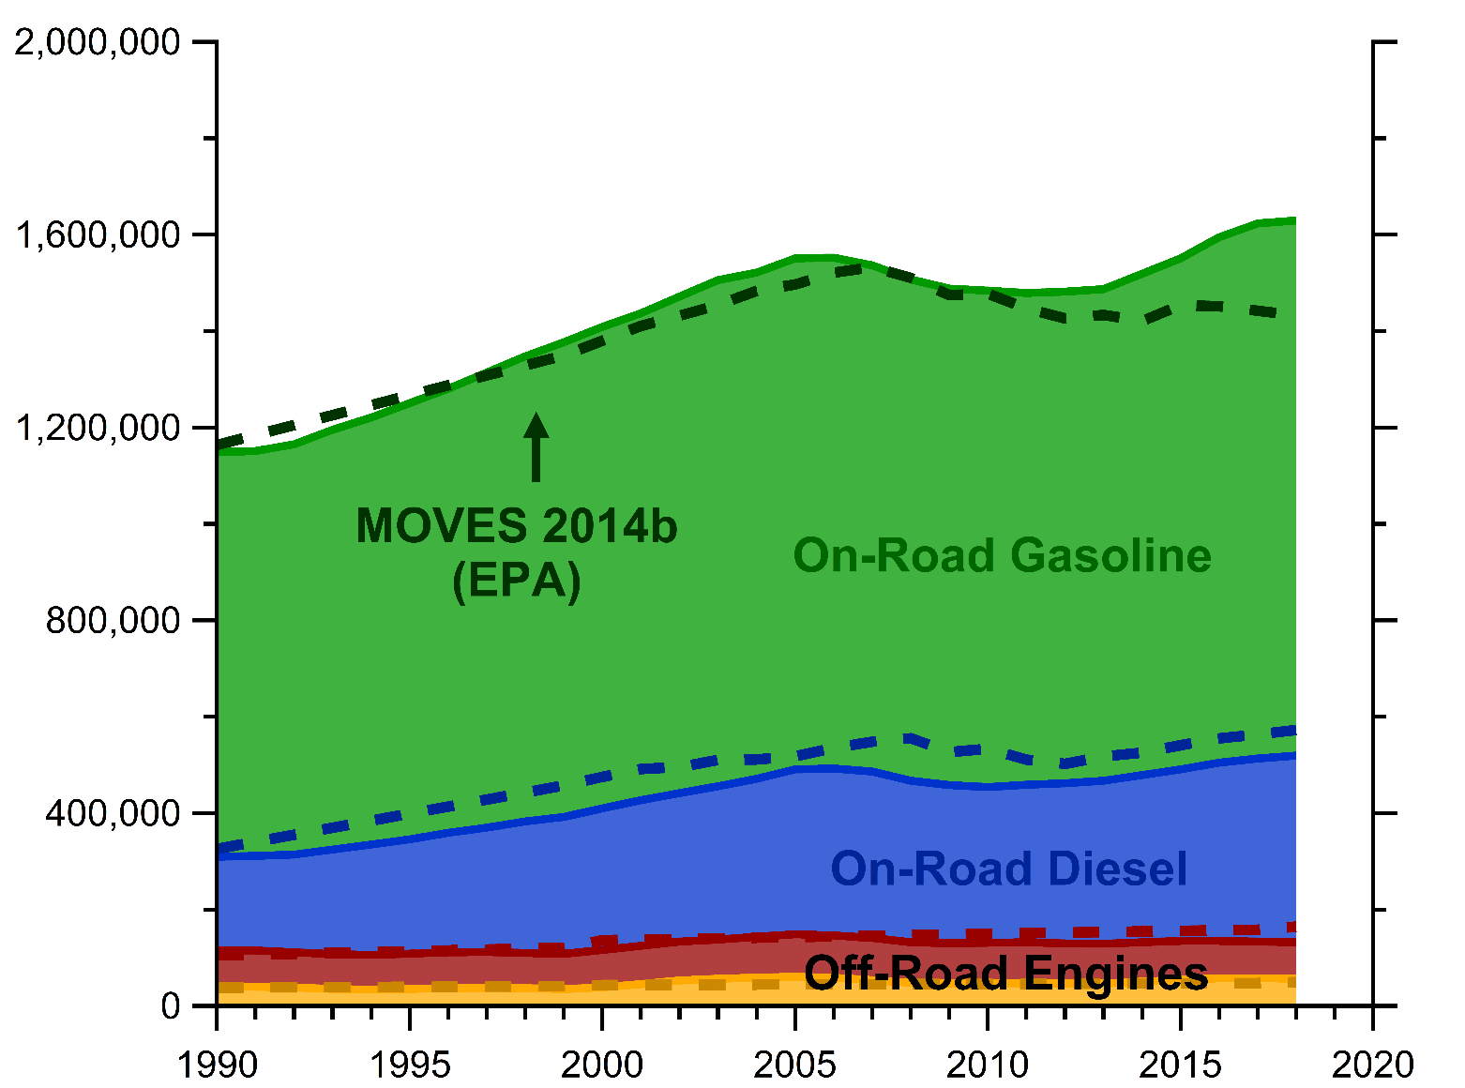
Trends in U.S. Mobile Source Activity (Fuel Use)
Emissions = Activity (kg fuel) x Emission Factor (g/kg fuel)
Fuel sales based on
US DOT and DOE surveys
reported annually by state
Fuel Use (t/d)
Year

Slide 6
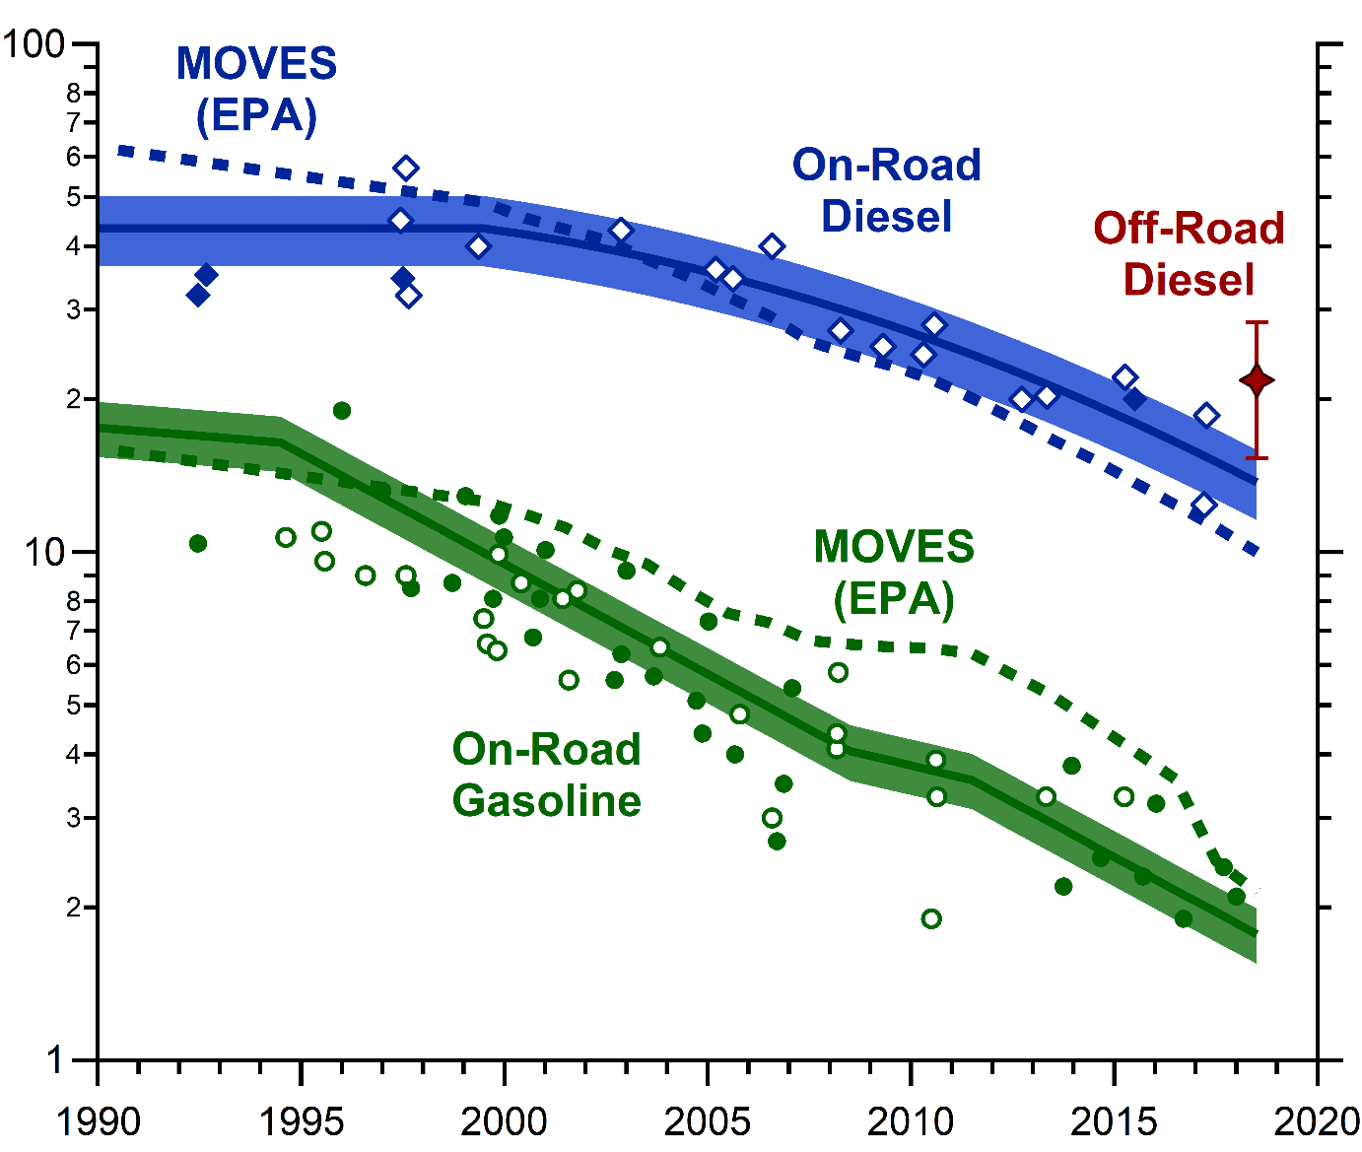
Trends in Mobile Source NO_{x} Emission Factors Updated to 2018
Emissions = Activity (kg fuel) x Emission Factor (g/kg fuel)
NO_{x} EF (g/kg fuel)
Diesel EF
within ~30%
Gasoline EF
within ~20%
(default from MOVES shown)
Year

Slide 7
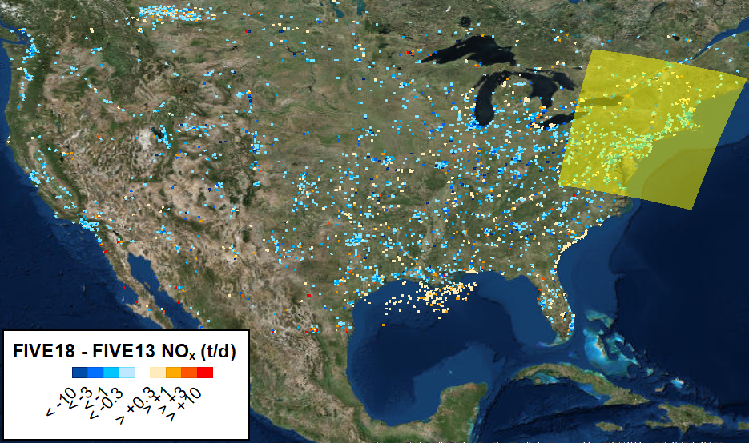
Updated US NO_{x} Emissions Inventory from 2013 to 2018
Total U.S. NO_{x} emissions decreases by ~3.5% y⁻¹
Updated mobile sources with FIVE
~60% of decrease
(2) Updated power plants with CEMS
~40% of decrease
(3) Updated other point sources to NEI14
Updated inventory (4 km x 4 km) for NO_{x}, CO, VOCs will be made publicly available

Slide 8
WRF-Chem Model Comparison of NO₂ with TROPOMI (July 2018)
Tropospheric NO₂ (molec. cm⁻²)
Meng Li (NOAA)
Recalculated AMF for TROPOMI NO₂ retrieval
allows for more “apples-to-apples” comparison
WRF-Chem (12 km x 12 km)

Slide 9
WRF-Chem Model Comparison of NO₂ with TROPOMI (July 2018)
Tropospheric NO₂ (molec. cm⁻²)
Tropospheric NO₂ (molec. cm⁻²)
WRF-Chem (12 km x 12 km)
TROPOMI (12 km x 12 km)

Slide 10
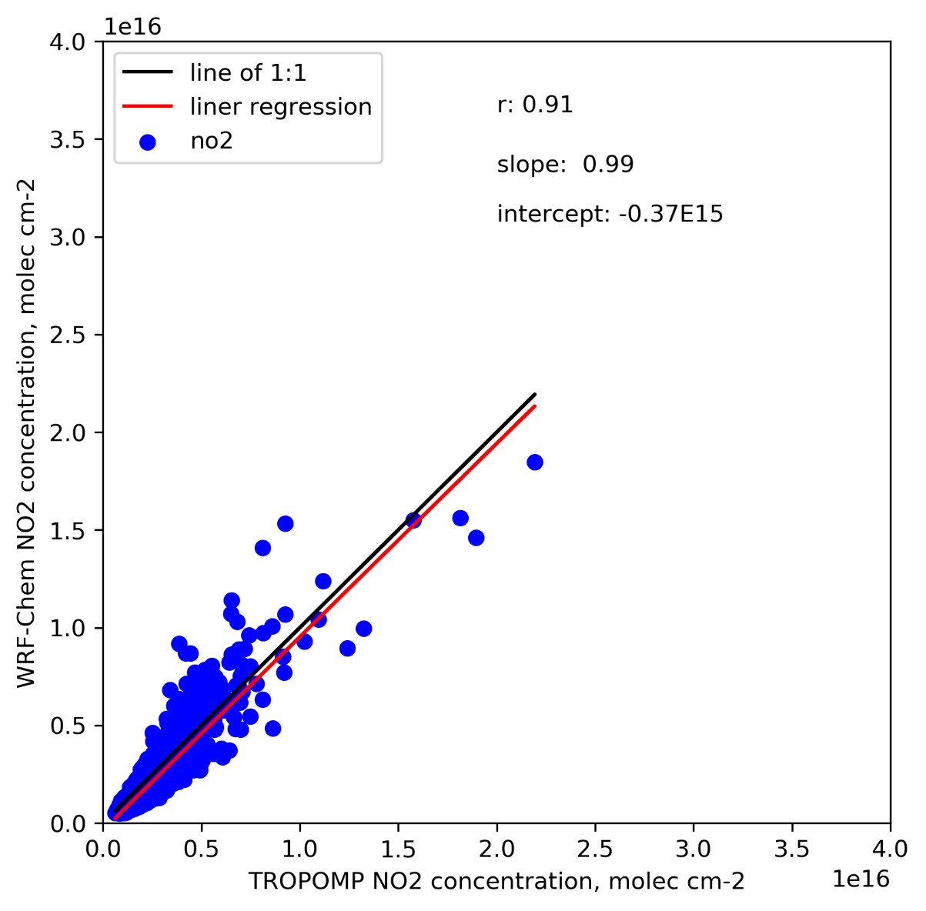
Model Results Generally Consistent with TROPOMI NO₂
WRF-Chem NO₂ (molec. cm⁻²)
NO₂ (molec. cm⁻²)
Slope = 0.99
r = 0.91
TROPOMI NO₂ (molec. cm⁻²)
WRF-Chem – TROPOMI

Slide 11
Sharper Spatial Features in Model and TROPOMI NO₂ Columns
I-95
I-95
NO₂ (molec. cm⁻²)
NO₂ (molec. cm⁻²)
NY Thruway
NY Thruway
WRF-Chem (4 km x 4 km)
TROPOMI (4 km x 4 km)

Slide 12
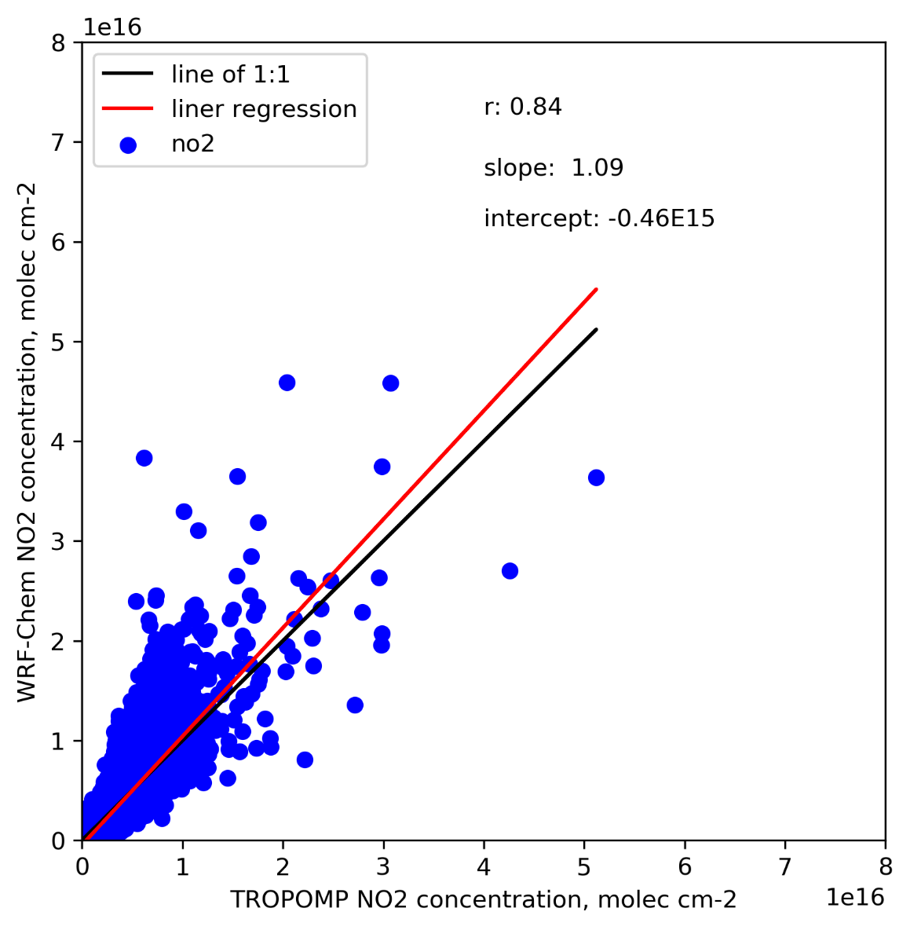
Model NO₂ Higher in Cities and Lower in Rural Areas
WRF-Chem NO₂ (molec. cm⁻²)
NO₂ (molec. cm⁻²)
Slope = 1.09
r = 0.84
TROPOMI NO₂ (molec. cm⁻²)
WRF-Chem – TROPOMI

Slide 13
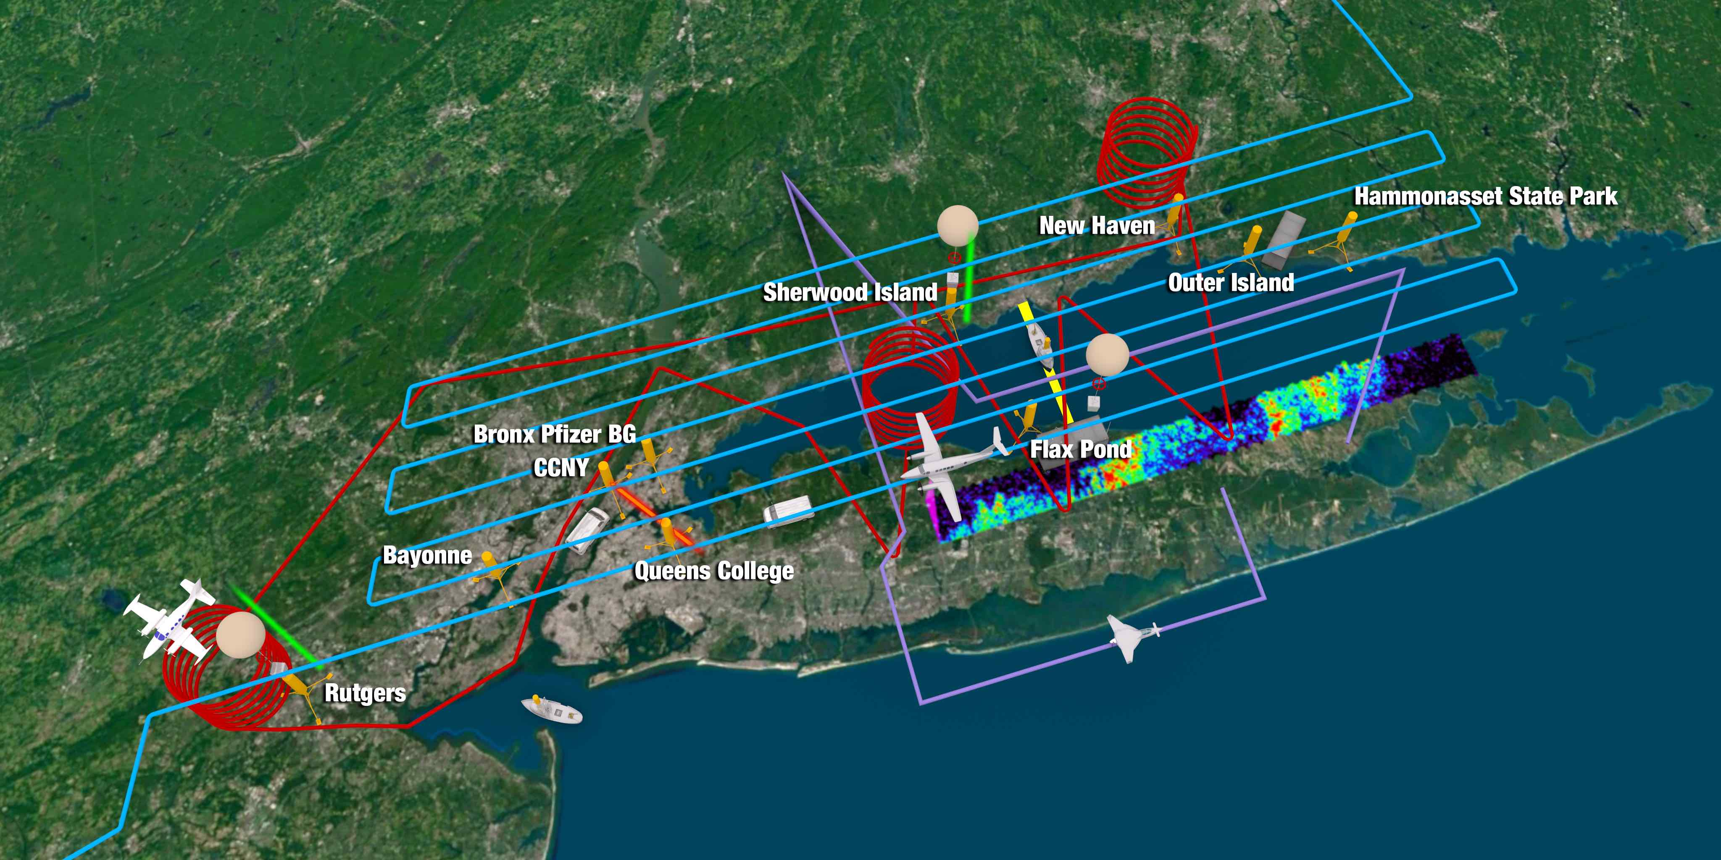
Long Island Sound Tropospheric Ozone Study (LISTOS 2018)

Slide 14
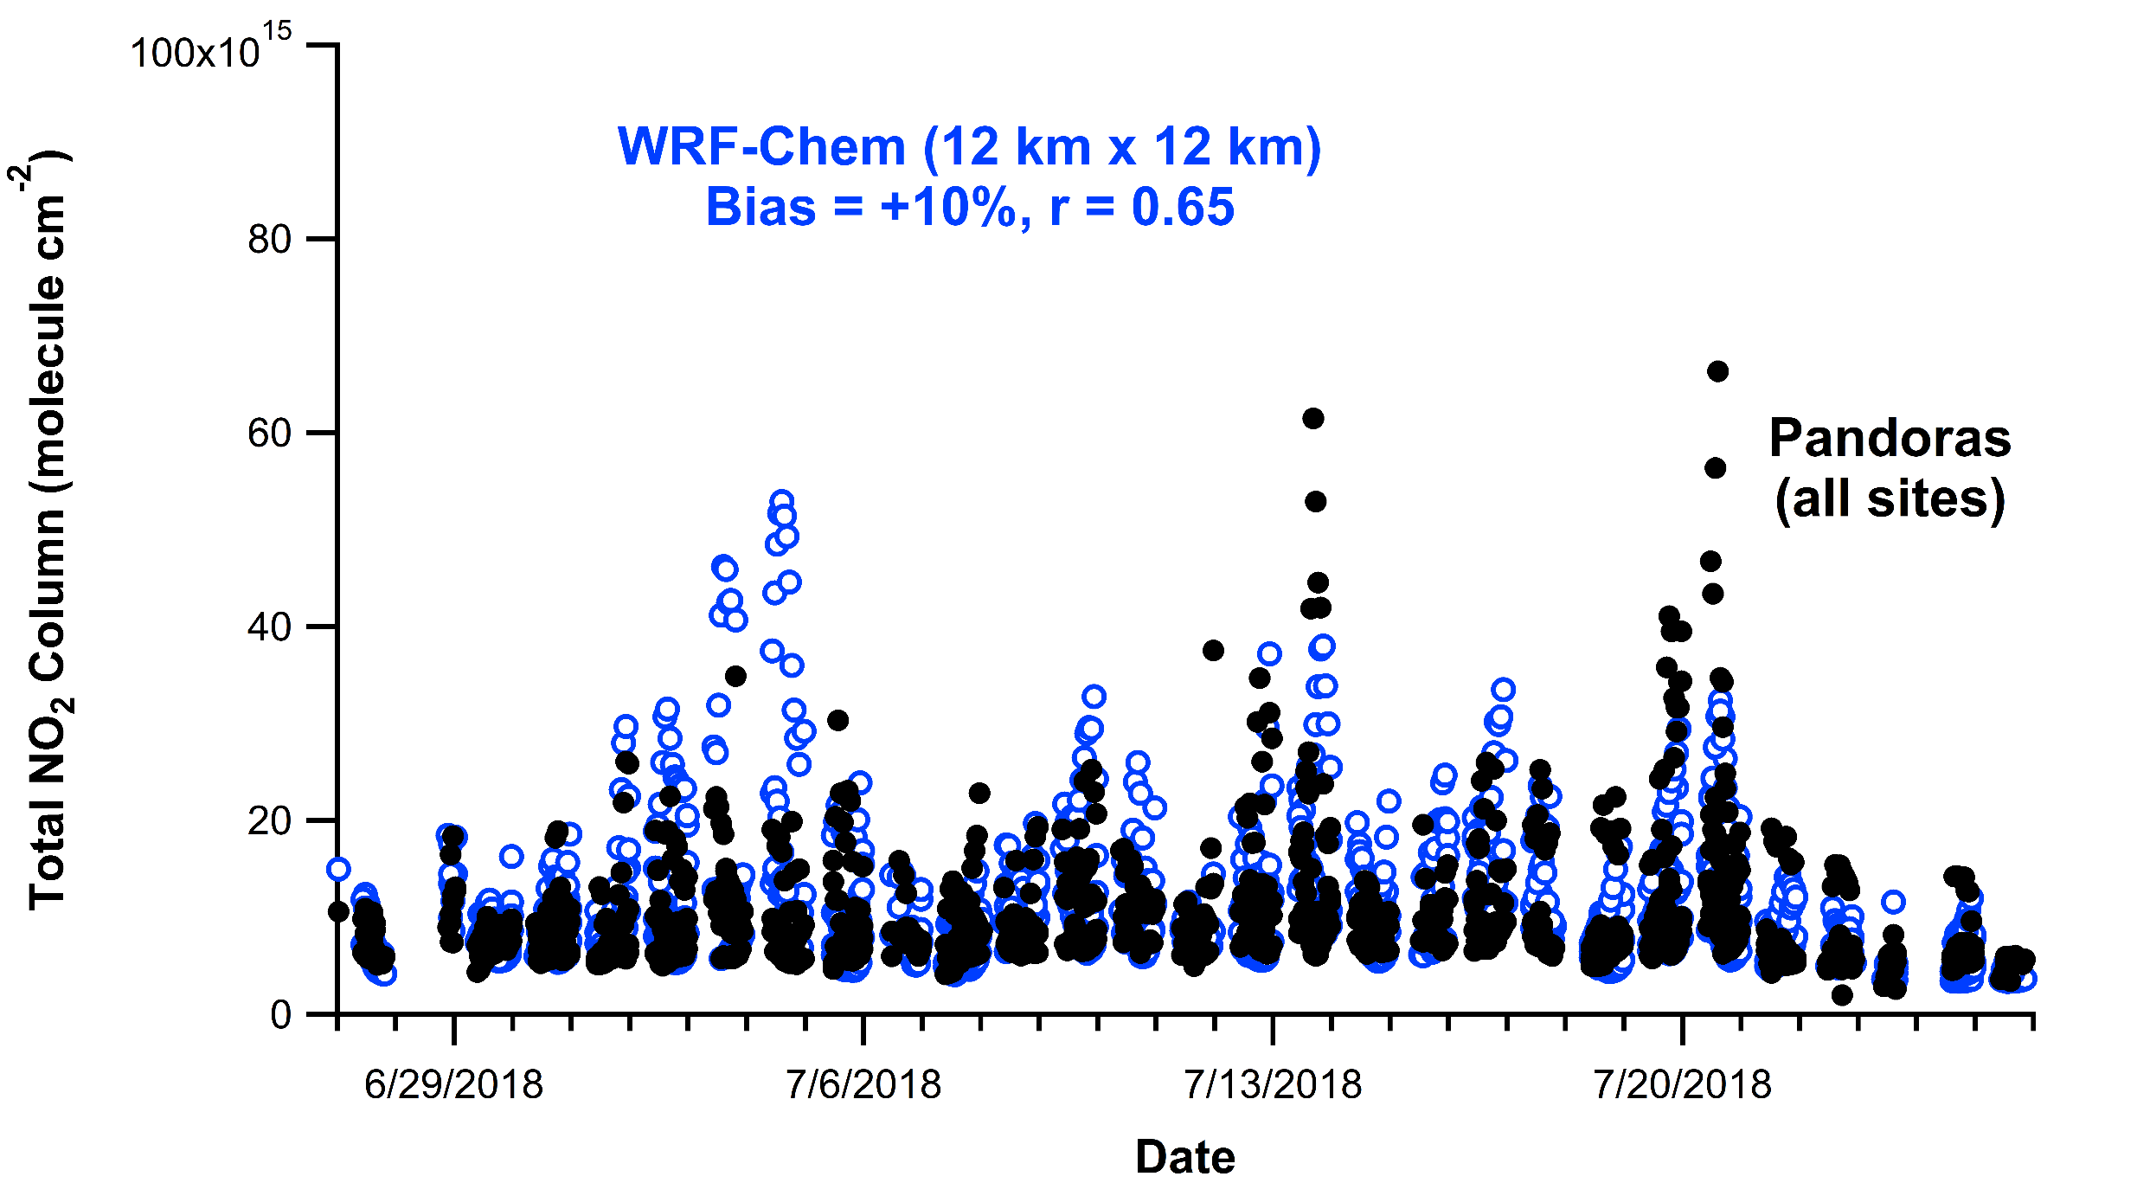
WRF Model Evaluation of NO₂ with Pandora Data in NYC Region
Acknowledgments: Luke Valin and Jim Szykman (EPA), Bob Swap, Nader Abuhassan, Alexander Cede (NASA)

Slide 15
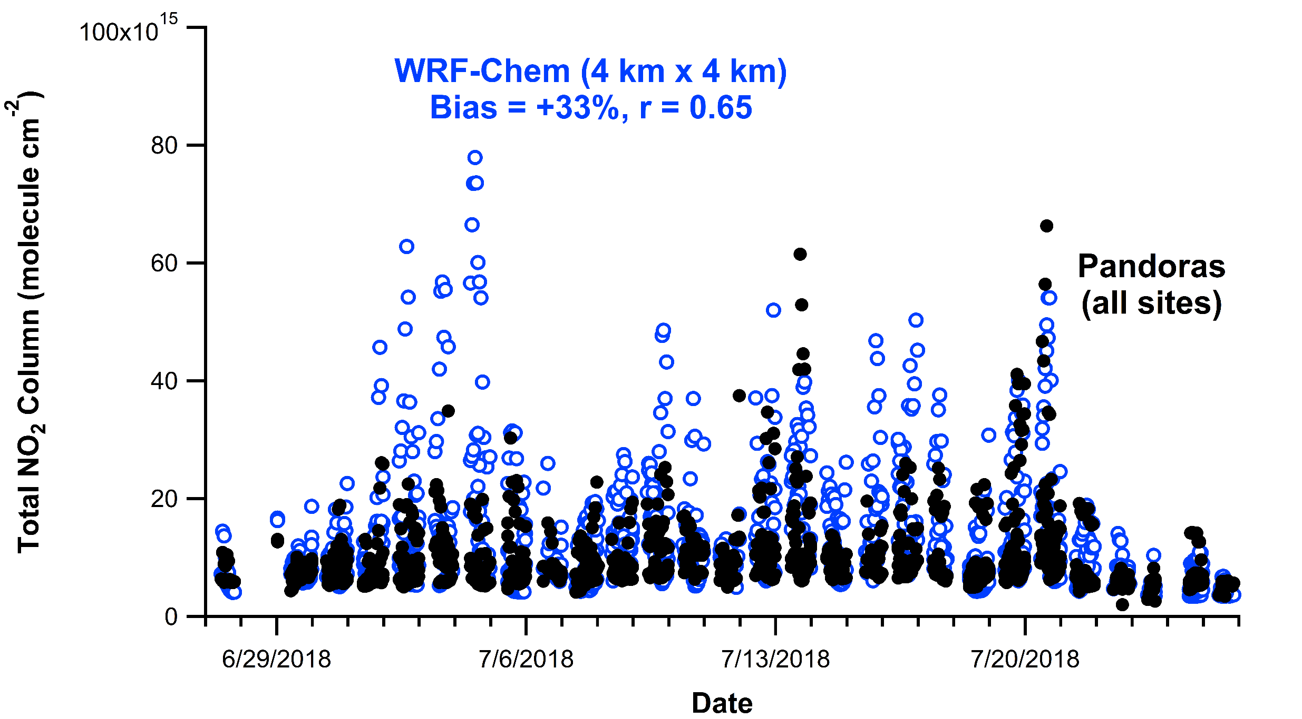
WRF Model Evaluation of NO₂ with Pandora Data in NYC Region
Acknowledgments: Luke Valin and Jim Szykman (EPA), Bob Swap, Nader Abuhassan, Alexander Cede (NASA)

Slide 16
Summary
Differences in 2018 mobile source NO_{x} emission inventories (MOVES2014b vs. FIVE) relatively small compared to previous years
No longer factor of ~2 difference in on-road gasoline emission factor
Updated 2018 NO_{x} emissions over Eastern US consistent with TROPOMI and Pandora NO₂ levels
Magnitude of model NO₂ within 0-30% of retrievals
(3) Observations raise potential issues with emissions and modeling
Is New York City plume being transported precisely?
Spatial and temporal allocation of emissions?

